Slide 1
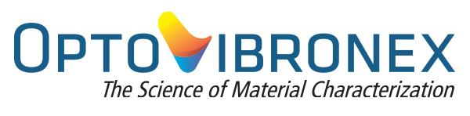
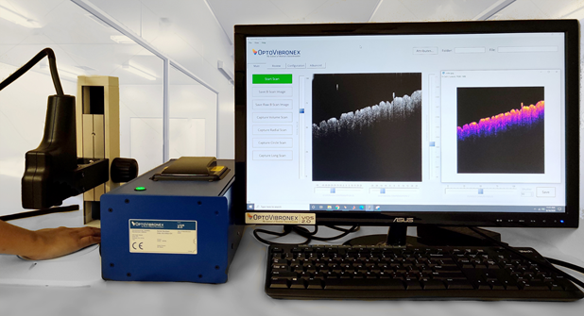
Offering a Device that can Produce a “Virtual Biopsy”
and
Offering the Ability To Non-Invasively Define Physical Biomechanical Biomarkers of Disease using Vibrational Optical Coherence Tomography (VOCT)

Slide 2

Unmet Market Need - Dermatology
  Skin Cancer Most Common form of Cancer
  5M skin cancers annually; 25M by 2050
  1 in 5 Americans by age 70
  41% increase in probability of dying from Melanoma if treatment is delayed
Current Methods Imprecise and Inefficient
  6-12 months’ wait for an appointment with a dermatologist
  55% of all biopsies are benign and thus may not be necessary
  Mohs Surgery cuts - average 1.74 cuts, average ranges from 1.09 – 4.11
  Attempts to Solve Problem
  600% increase in Mohs surgeons over the past 10 years
  Significantly greater demand for skin lesion diagnoses and treatment than there are Dermatologists/Mohs Surgeons

Slide 3

Unmet Market Need - Ophthalmology
  The Number of Ophthalmologists Decreasing Year to Year – American Association of Medical Colleges (AAMC) estimates a shortage of approximately 6,000 ophthalmology providers in 2025
  The Magnitude and Frequency of Numerous Eye Conditions is Increasing
    Keratoconus (1982 1 in 1,835; 2020 1 in 750; some populations 1 in 84)
    Myopia (2010 - 34% of North America population; 2050 - projected 58%, some population segments 80-90%)
    Glaucoma – 3 million Americans and the second leading cause of blindness
  Many ocular diseases require surgery and/or the use of therapeutic or experimental drugs for treatment - which can only be performed by ophthalmologists who are MDs
No Quantifiable Methods to Differentiate Normal Ocular Anatomy from Ocular Disease Progression
No Quantifiable Methods to Track the Progress of New Treatments

Slide 4
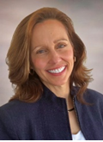
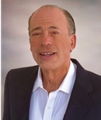
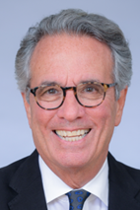
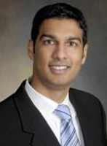
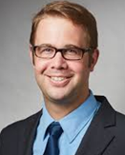
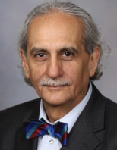
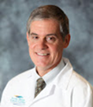
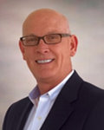
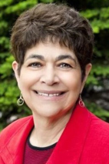
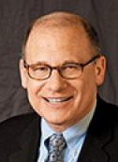
Management Team / Key Advisors
  Lisa Lutz Silver (51% ownership)
  Co-Founder – President
Fred Silver, PhD (42% ownership)
  Professor of Pathology at Robert Wood Johnson Medical School
  Co-Founder - Chief Technology Officer
Business Expertise
  Prior: Sales Executive at IBM (25+ years)
  Entrepreneur/Small business owner (10+ years)
Scientific Expertise
  Ph.D. from MIT
  Entrepreneur / Small business owner (30+ years)
  20+ patents; published 220+ papers
Clinical Advisors
Dom Benedetto, MD (Ophthalmologist)
Hari Nadiminti, MD (Dermatologist – Summit Health – New Jersey)
Ian Odell, MD, PhD (Dermatologist - Yale New Haven Hospital)
Jose Pulido, MD, MS, MBA, MPH (Wills Eye Hospital – Director Translational Medicine)
James Grichnik, MD, PhD (Professor and Chairman, Department of Dermatology & Cutaneous Surgery at University of South Florida)
Clinical Expertise
  Dermatology
  Ophthalmology
  Mohs Surgery
  Extensive microsurgical experiences and research publications
Commercialization/Business Expertise
  Led U.S. pre-launch & launch of UCB Pharma’s
  Keppra® - blockbuster seizure drug
  Authored first Cologuard® commercial plan
Commercializtion/Business Advisor
  Andrew Shales (1% ownership)
  (CEO ResiliaPharma)
Regulatory Consultant
Susan Alpert, MD, PhD.
Regulatory Expertise
  Former Director of Device Evaluation for FDA
Reimbursement Consultant
Joel Brill, MD, AGAF, FASGE, FACP, FACG, CHCQM
Reimbursement Expertise
  Extensive CMS and AMA Experience

Slide 5
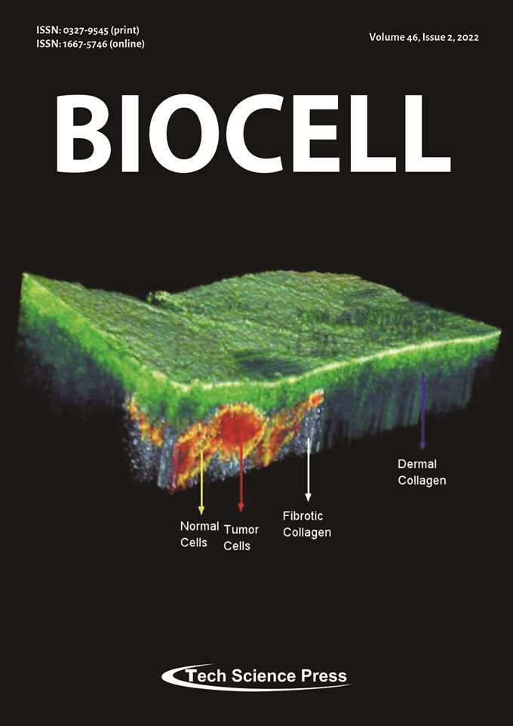
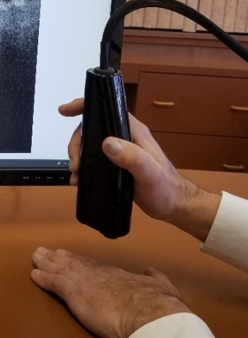
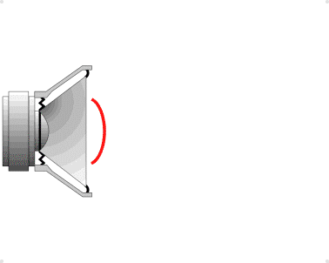


  Our Solution: For Dermatology -Virtual Biopsy through “VOCT”
Speaker /
Transverse Sound
OCT / Light
Virtual Biopsy (non-invasive PHYSICAL analysis)
What it looks like, and how it behaves
More accurate than current visual screening
Can augment visual screening and dermoscopy
For Skin Lesions - Precise lesion margins & depth in 15 minutes (physical biopsy = up to 72 hours)
Minimizes incomplete removal of malignant tumor
Preserves maximum healthy tissue – minimizes scarring

Slide 6
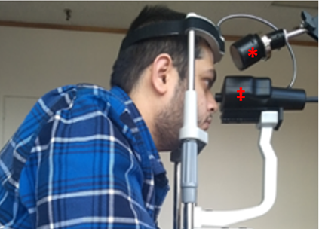
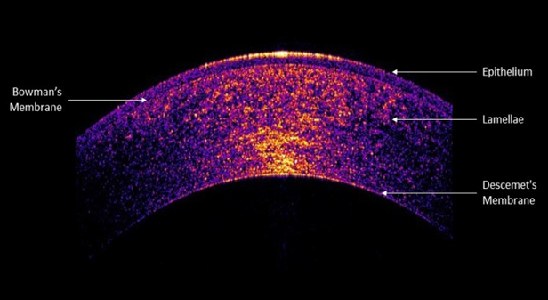
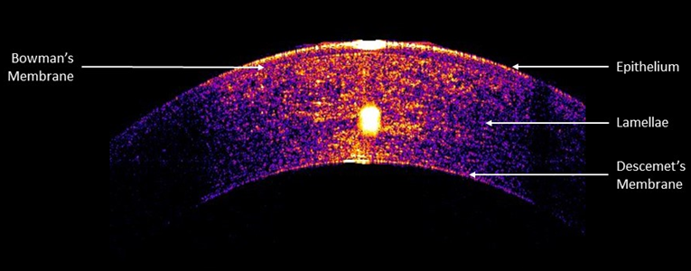
Our Solution for Ophthalmology - VOCT for the Eye
Virtual Biopsy (non-invasive PHYSICAL analysis)
What it looks like, and how it behaves
No other method directly measures the biomechanics of individual eye components (i.e. corneal, retina, optic nerve, sclera, limbus, lens)
VOCT is very high resolution and is noncontact
VOCT utilizes sound at safe levels
Keratoconus Cornea
Normal Cornea
Keratoconus Cornea

Slide 7
  Current Status
FDA Breakthrough Device Designation Approval
Aid for the dermatologist to augment visual and dermoscopic analyses
    For non-invasive quantitative determination of fibrous & cancerous tissues;
Enable the dermatologist to identify the lesion margins and depth non-invasively;
Allow the dermatologist & patient to know how much surgery is needed to remove
  The whole tumor in one surgical procedure & minimize the unnecessary removal of healthy tissue
Dermatology
Clinical Studies ongoing with Summit Health in New Jersey
(2,500 providers; 12,000 employees; 340 locations in NJ, NY, CT, PA)
  Pigmented Lesions and Melanoma Detection
Initiating Clinical Studies with Cleveland Clinic in Vero Beach
Additional potential application - quantifiable cosmetic treatment effectiveness
Ophthalmology
Clinical Studies ongoing with Wills Eye Hospital in Philadelphia
  Focused on Corneal Involvement in Keratoconus, Glaucoma and Myopia
Retinal Disease Clinical Studies beginning with Wills Eye Hospital in Philadelphia

Slide 8
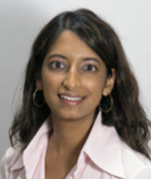
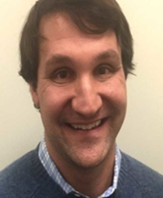
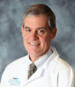
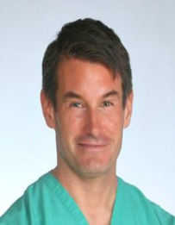
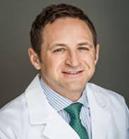
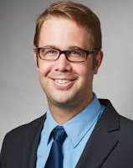
Insights from Prospective Customers (70+ Interviews in the Dermatological Ecosystem)
“help me find the margins.. more cuts .. big problem.”
“I can’t afford to hit a blood vessel”
Monika Srivastava, M.D.
Dermatologist/Mohs Surgeon
Michael Richard, M.D.
Oculofacial Plastic Surgeon
Hari Nadiminti, MD
Summit Health
“Give me a stiffness map superimposed over an image.”
“Differentiating pigmented lesions and Melanoma with VOCT would be a MAJOR breakthrough.”
“I often cut in excess of 5 times.”
James Grichnik, M.D., Ph.D.
Dermatologist/Mohs Surgeon
University of Southern Florida
Stephen Spates, M.D. Dermatologist/
Mohs Surgeon
“is it cancerous or not. I don’t want to wait for biopsy results. How much does it cost?”
“I just biopsy everything…
not everyone wants a biopsy.”
Matt Halpern, M.D. Dermatologist/
Mohs Surgeon
Ian Odell, M.D., Ph.D.
Dermatologist - Yale
New Haven Hospital

Slide 9
Our Value Proposition - For Dermatology
  For the Physician (first customer target)
  Increase patient surgical throughput by up to 50%
  Increase volume of patients accurately screened
  Minimize diagnostic time – better patient outcomes
  Increase patient satisfaction
For the Patient
  Minimize wait time for biopsy results from 1 hour to days down to 5 – 15 minutes
  Minimize the number of cuts
  Minimize healthy tissue removal – especially on the face
  For the Payer
  Decrease amount of payments for benign biopsies – currently 55% of total
”Basil Cell Carcinoma, on my lip… The Dermatologist could not tell me the extent of the remaining cancer cells. I have to have Mohs Surgery…. the Dermatologist is preparing me for the worst.”
Sent: Sun, Nov 24, 2019 at 7:23 PM Patient: Peter H

Slide 10
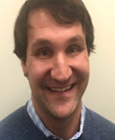
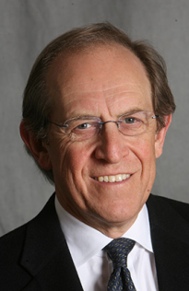
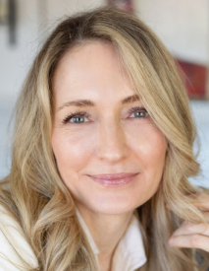
Secondary Dermatology Market (Aesthetic Dermatological )
Market research - aesthetic physicians want to quantify results
Patients pay cash, can be thousands of dollars per treatment
VOCT studies can measure tissue changes over time – quantifying increases in collagen
These studies offer the potential to quantify results and make product commercial claims
OptoVibronex believes this technology will become the “gold standard” for evaluation of aesthetic products/services
“Fillers and lasers are supposed to build collagen. Quantifying changes over time would help the patient with the cost/benefit analysis of multiple treatments.”
“If my patients see results they are willing to
spend thousands of dollars on younger looking skin.”
Michael Richard, M.D.
Oculofacial Plastic Surgeon
“My clients are always looking for new treatments to help their skin look younger.”
Leonard Miller, M.D.
Boston Center for Facial Rejuvenation
Beverly Sidders, Founder
The Skin Clinic of Virginia

Slide 11
Insights from Ophthalmological Clinical Collaborators
“Great news! We would love to work with VOCT to get normative data and results in keratoconus as the first area we study. This is very promising!”
Jose Pulido, MD, MS, MBA, MPH
Wills Eye Hospital
“VOCT can be a practice-wide game changer for Ophthalmology. It has the potential to identify patients at risk for developing some of the most common problems like nearsightedness, glaucoma and common corneal diseases. VOCT also has the potential to stratify risk and monitor the progression of disease and the effectiveness of present and future drug and surgical treatments.”
Dom Benedetto, MD
Center for Advanced Eye Care

Slide 12

Addressable Market
Approximately 10,000 Dermatologists in the US
      2% adoption rate = $5M base-line revenue target in annual revenue by 2027
First targeted markets: FL, NJ, PA, MD, CT, NY (28% of total)
    Secondary Targeted Markets – CA, TX, AZ (26% of total Dermatologist Market)
    Dermatology diagnostic device market: $2B in annual sales (2017)
    Expected to grow to $5B by 2025 (+12% CAGR)
  OCT market: $700M in annual sales ($54M in Dermatology)
    Untapped market due to OCT device cost & lack of FDA approved billable indications
    Our technology is superior and can be at a lower cost
Approximately 18,500 Ophthalmologists in the US
      In approximately 7,000 private practices
      2% adoption rate = $3.5M base-line revenue target in annual revenue by 2028
  OCT market: $700M in annual sales ($500M in Ophthalmology)
    Our technology is superior since it provides quantitative information and can be at a lower cost
Long-term vision:
Platform technology with other medical and non-medical (industrial applications)

Slide 13
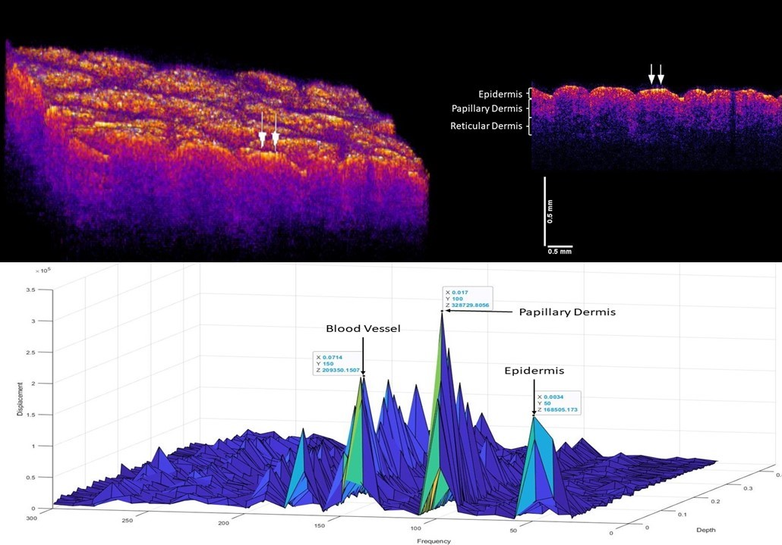
Normal Skin

Slide 14
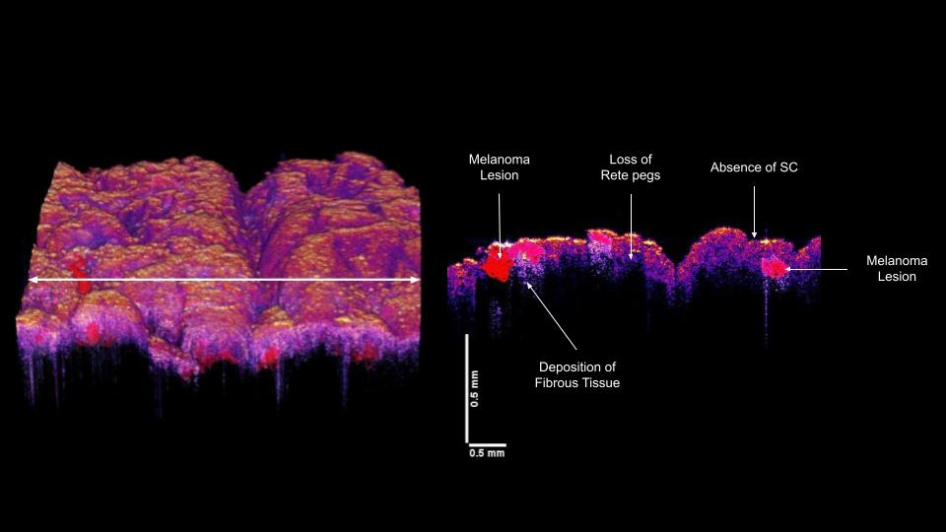
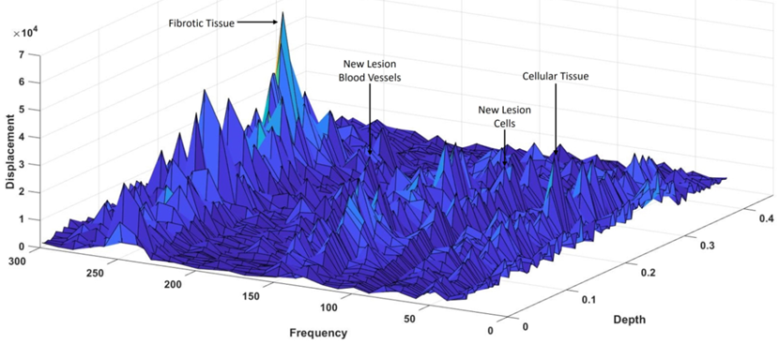
Melanoma

Slide 15
Machine Learning
Utilizing Machine Learning to eliminate human error and increase speed and accuracy of diagnosis
Preliminary results illustrating cancer diagnosis using VOCT and machine learning
Data with 40 subjects demonstrates the accuracy of diagnosing different skin cancers
This will improve as more data is collected
 | BCC | SCC | Melanoma
Sensitivity | 90.9% | 91.6% | 83.3%
Specificity | 87.5% | 87.5% | 77.8%

Slide 16

Competitive Landscape
 | VOCT | Visual | Dermo-scope | OCT | Elastography | Confocal Microscopy | Near Infrared Microscopy | Ultrasound
Current Usage | Clinic | Clinic | Clinic | Clinic/Lab | Lab | Lab | Lab | Clinic/Lab
Screening time 15 minutes |  |  |  |  | X | X | X | 
Cost (<$100 per procedure) |  |  |  | X | X | X | X | 
Ease of use |  |  |  |  | X | X |  | X
Sound Wave | Transverse | N/A | None | None | Shear | None | None | Shear
Measure cellular and collagen stiffness |  | X | X | X | X | X | X | X
Image Quality | Moderate | Moderate | Moderate | Moderate | Moderate | High | Moderate | Poor

Slide 17

Platform Technology
Leverage our innovation into other fields of use
Expandable into Multiple Markets

Slide 18
Product Launch Plan - Dermatology
Exclusive worldwide license rights from Rutgers University
  Patent issued in the US (15/776,287); Claims Accepted/Patent pending in Europe (16866811.9)
    Breakthrough Device Designation obtained in June 2022
Achieved Extensive Customer Discover Efforts
2 NSF I-Corps
      Rutgers & MD Anderson Cancer Center in Houston
      Interviewed 65+ individuals
    Target Identified Initial Market Entry Archetype
        1 – 3 Physician Practices (30% of all US practices have 1 Dermatologist)
        Typically under 40 years old motivated to grow practice and comfortable with new technology
    Phase I:
      Leverage our relationships with KOLs, attend conferences, continue publishing in prominent journals
      Fee for service screening of patients (no capital investment for early adopters)
    Lower barriers for adoption; align with customer revenue model
    Utilize New Approved Reimbursement Codes Unique for OptoVibronex’s Breakthrough Device Designation
    Phase II:
      Direct sale or rental of device; fee for service reserved for initial customers only
      Ramp up software sales and services revenue (software upgrades / improved algorithms)

Slide 19
Development Plans: Technology and Funding Requirements and Exit Strategy
Key Tasks & Milestones:
First 510(k) FDA clearance
  Class II Device
  Based on breakthrough device designation & existing predicate
  Image scanning only
  Collect additional lesion data
  n=100 ex-vivo
  n=100 in-vivo
Second 510(k) FDA clearance
Class II Device
Assist Physicians in the Diagnosis of Skin Cancer
Expand data collection
n= 400 in-vivo
Full product launch
Outsource device manufacturing
Consider M&A/Licensing Technology/Other Uses
  Medical Device Companies
  Industrial Applications
Timeline:
6-12 months
12 months
2-3 years
2Q23
2Q24
2027
Funding
Required:
$500K
$1.3M -$2M
$2M - $5M
Cumulative:
$500K
$1.8M - $2.5M
$3.8M - $7.5M
(Grants, SBIR I,
Angel/Seed)
(SBIR II, Angel/Seed, Corporate Partnerships)
(Angel, Venture Capital, Corporate Partnerships)
Cumulative Funding To-Date:
Other Notables:
  Co-Founders personal capital thru 2022 (~$445K)
  Rutgers Genesis Matching Grant - $40K
  Funding from Wills Eye Hospital - $92K
  Sweat equity

Slide 20
Why OptoVibronex
Experienced Team
Disruptive New Testing Methodology – Breakthrough Device Designation for Dermatological Indications
Recent Grant Recipient – Rutgers Genesis Matching Grant
Funding from Wills Eye Hospital
Identified Large and Growing Initial Target Market
Platform Technology with Significant Future Opportunities
  Medical Applications – Dermatology, Ophthalmology, Breast Cancer Detection, Aesthetic/Cosmetic Dermatology, Orthopedics, Neurology and Vascular Surgery
  45% of all global deaths associated with tissue/organ fibrosis – large amounts of fibrosis seen with x-ray, MRI, ultrasound, biopsy. We can detect small amounts of fibrosis and coupled with ultrasound can detect fibrosis in deeper tissue
  Industrial Applications
Licensing Opportunities

Slide 21
THANK YOU!

Slide 22
APPENDIX

Slide 23
CAP TABLE
Entity | Current % Ownership | Future % Ownership
Lisa Lutz Silver | 51% | 46%
Fred Silver | 42% | 37%
Rutgers University | 6% | 6%
Andrew Shales | 1% | 1%
Employee Future Ownership |  | 10%

Slide 24
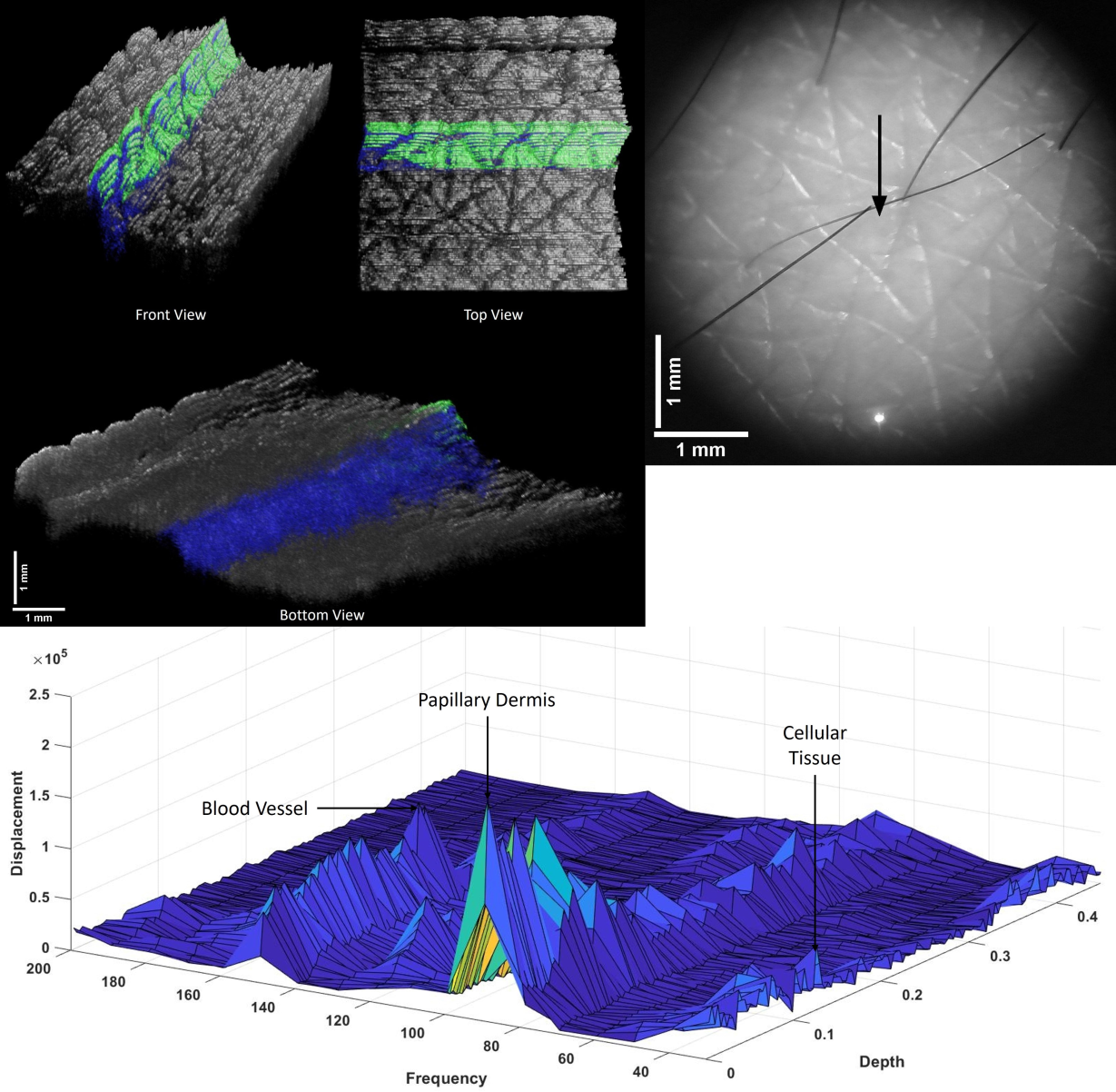
Normal Skin

Slide 25
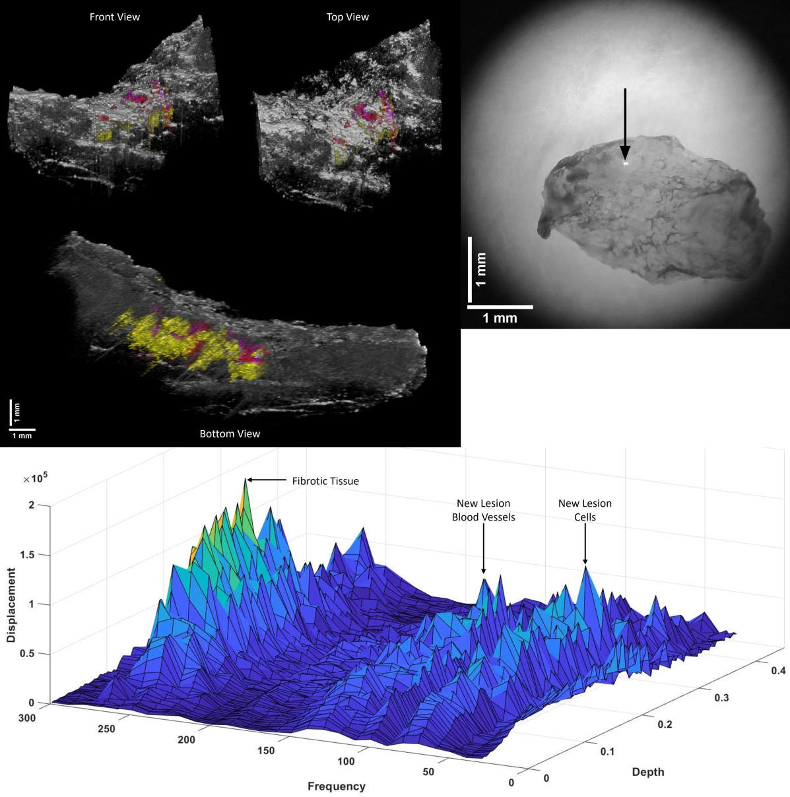
Nodular Basal Cell Carcinoma

Slide 26
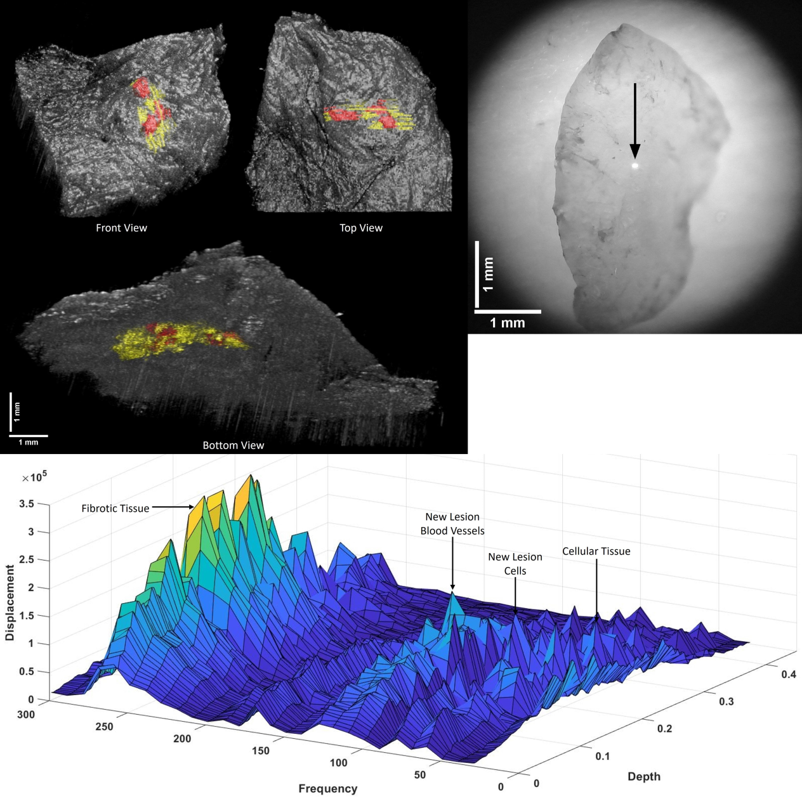
Superficial BCC

Slide 27
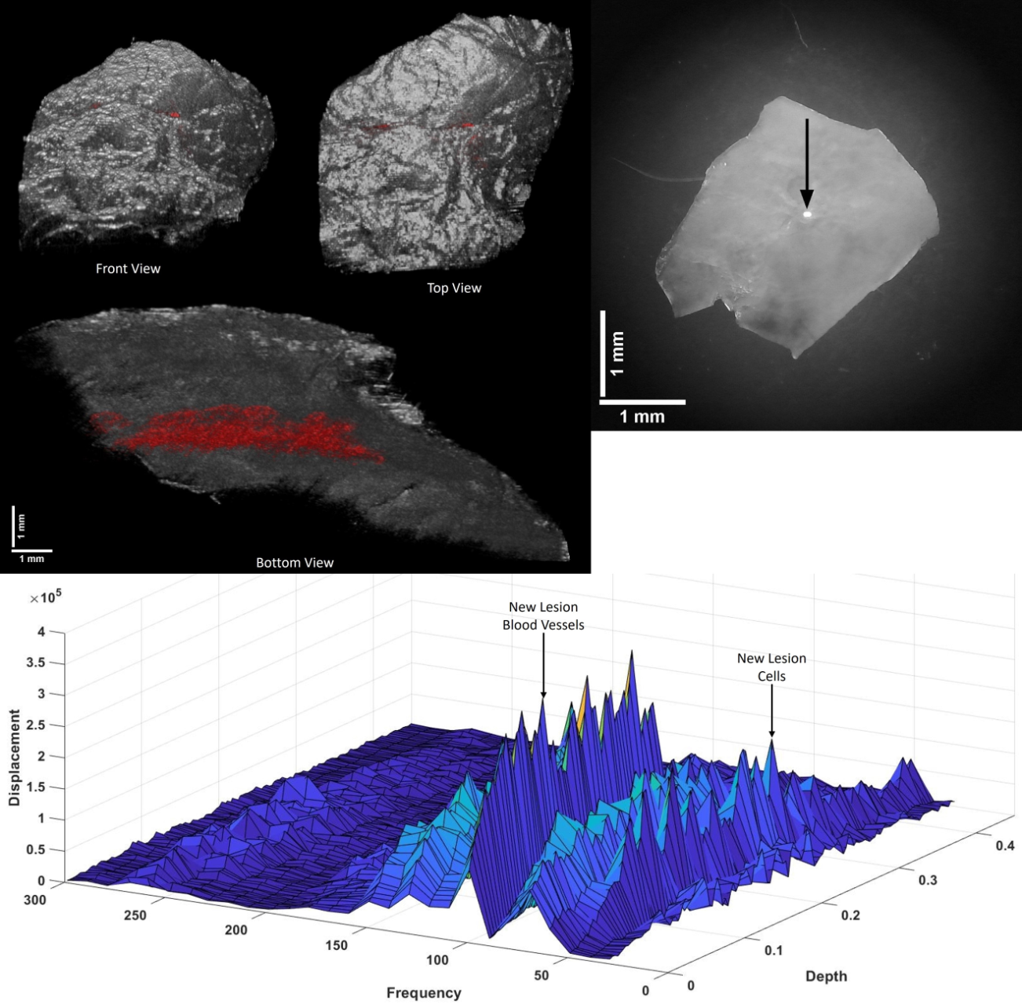
Actinic Keratosis

Slide 28

Squamous Cell Carcinoma

Slide 29

Melanoma

Slide 30
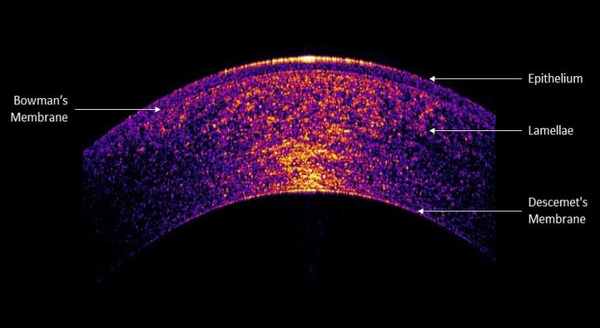
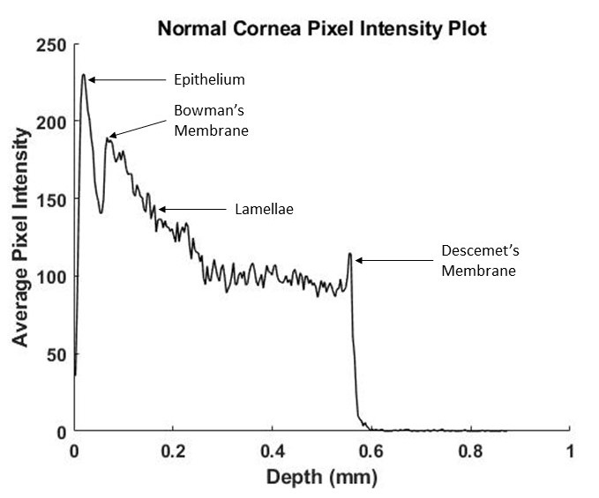
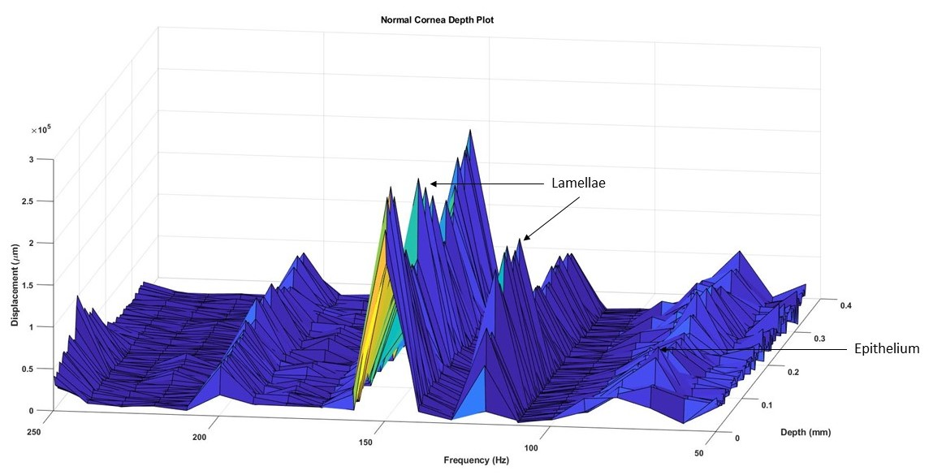
Corneal Applications

Slide 31
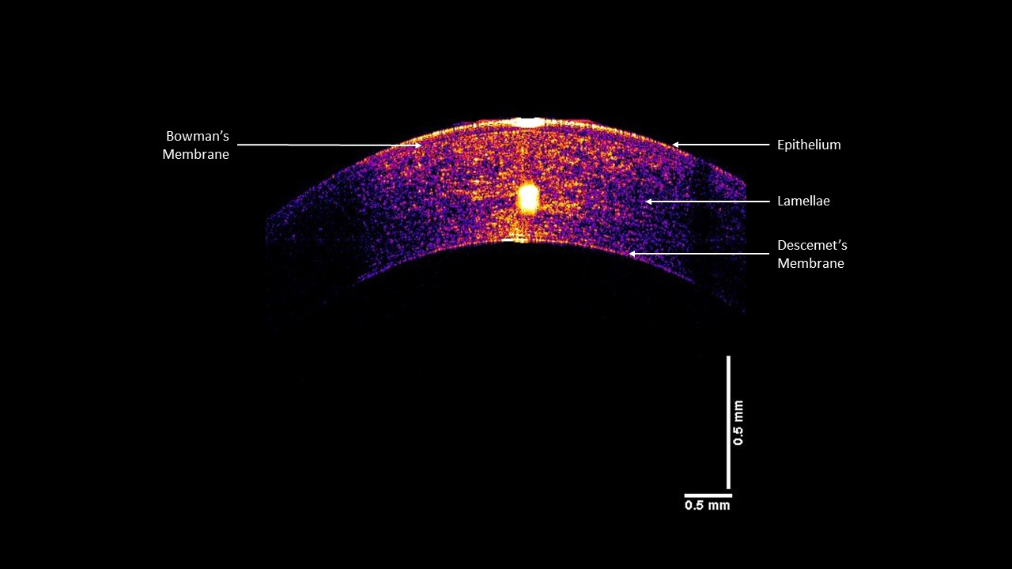

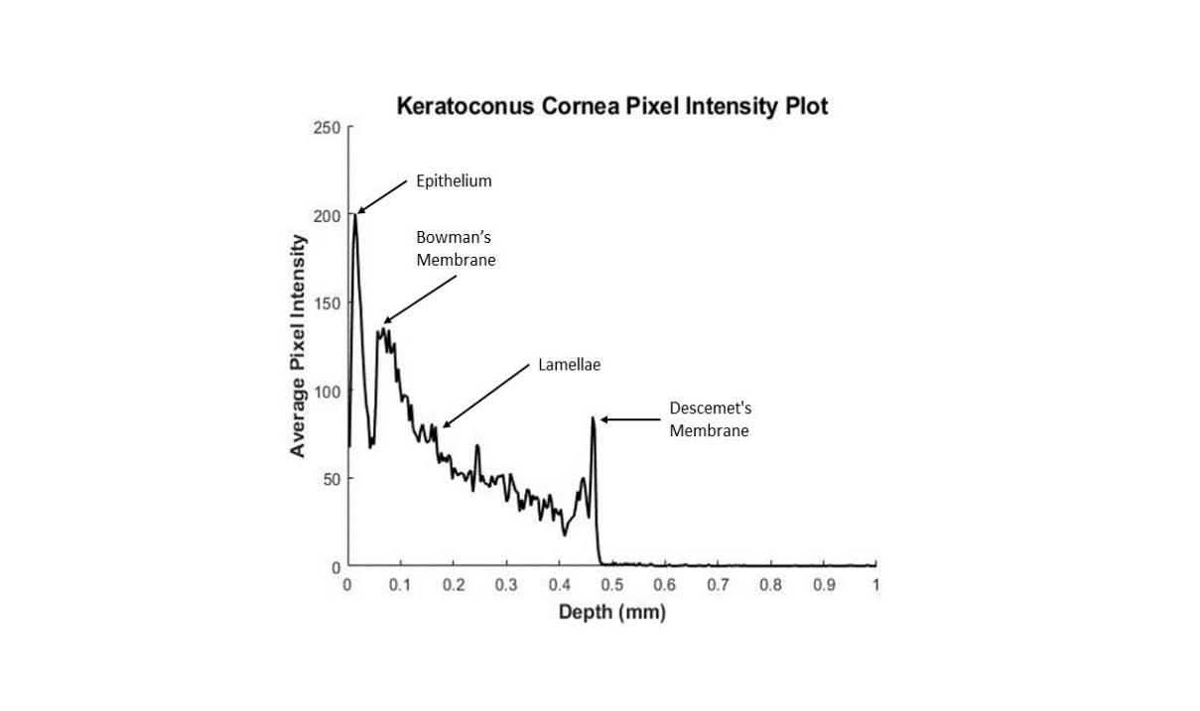
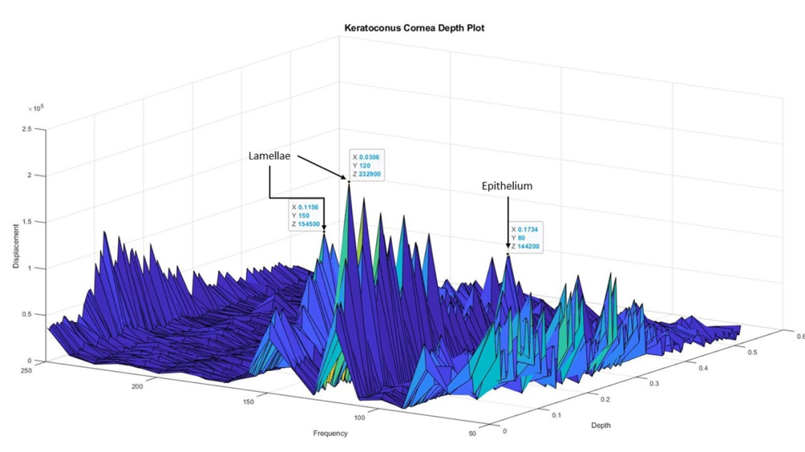
Keratoconus Cornea

Slide 32
Next Steps
Continue Skin Cancer Clinicals with Second Site for FDA 510K Approval Since Breakthrough Device Designation Received July 2022.
Use Machine Learning Techniques to Diagnose Melanoma
Submit NIH Grant Application to Continue Dermatological Validation of VOCT Approach
Develop the Vibrational OptoScope to be used to Clinically Diagnose and Evaluate Treatments for Invasive Cancers
Utilize Machine Learning Techniques to Enhance the Usability of the Vibrational OptoScope in all Application Areas
Continue Work with Wills Eye Hospital on Eye Diseases such as Keratoconus, Myopia, Glaucoma, etc.
Submit NIH Grant Application to Continue Research on the use of VOCT to Diagnose Eye Disease and Track the Effectiveness of Disease Treatments

